Slide 1

MOVIE RECOMMENDATION SYSTEM
MOVIE RECOMMENDATION SYSTEM
TEAM PYPERCLIP
Ridhi KC (18Z241)
Rohith CK (18Z242)
Sandhya R (18Z245)

Slide 2
PROBLEM STATEMENT
With the exponentially growing number of movies coming up every day, we often find it difficult to discover those that suit our preferences and tastes. Furthermore, the time that we are restricted to/ can afford to spend on this type of entertainment caters to the need for a system that can easily help us find movies of our inclination. The Movie Recommendation System aims to recommend movies to users based on their tastes and preferences.

Slide 3
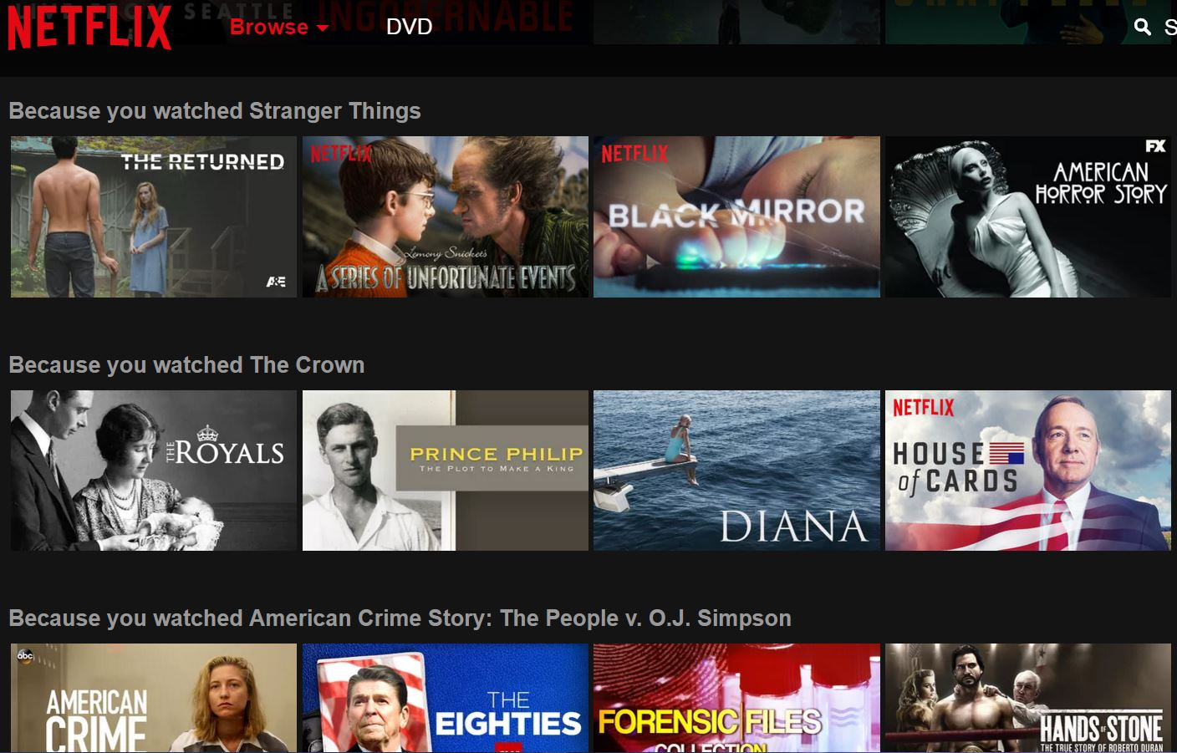
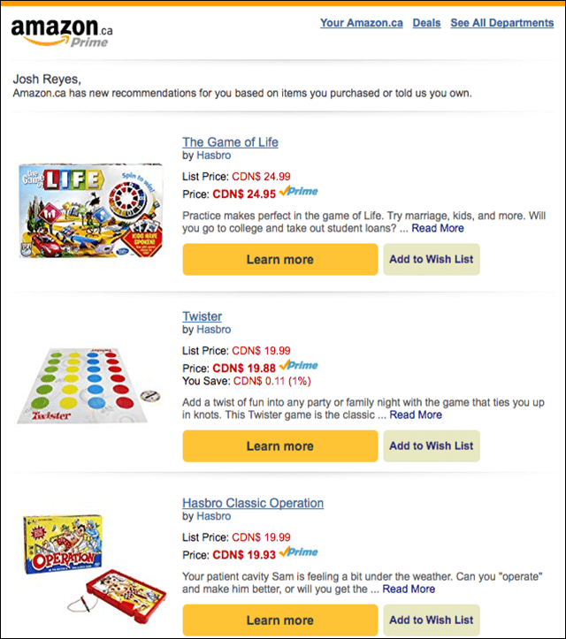
RECOMMENDATION SYSTEMS
The systems entice users with relevant suggestions based on the choices they make.
Better user experience
Preference-based relevant data is revealed
Recommendation systems match each user to various items of the system.

Slide 4
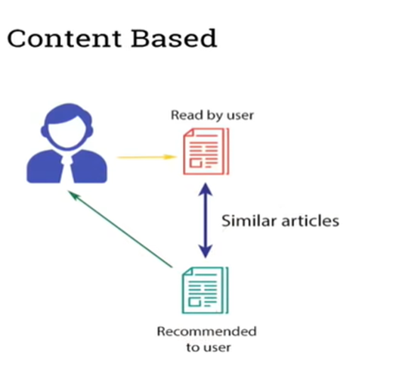
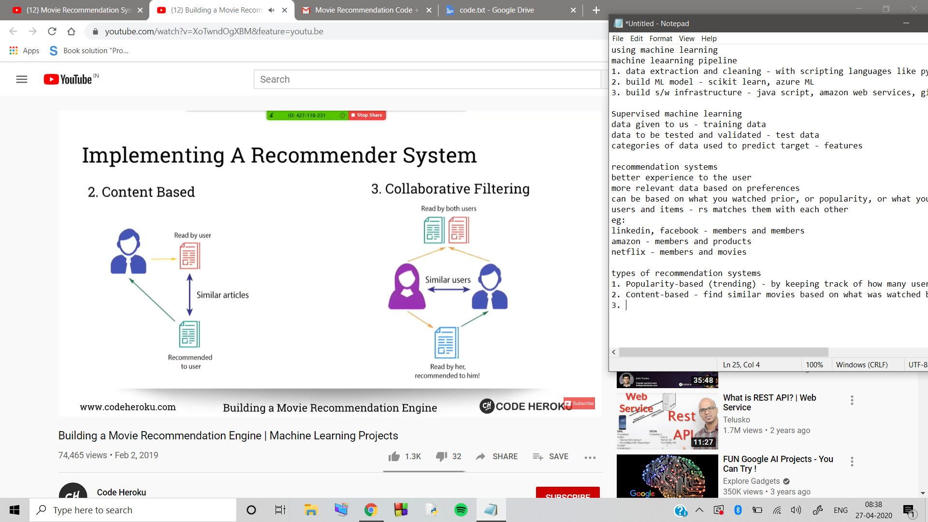
TYPES OF RECOMMENDATION SYSTEMS
Content-based
Finds similar movies based on what was watched before
Collaborative filtering
Peer-to-peer suggestions
Popularity-based (Trending)
Keeps track of how many users view it

Slide 5
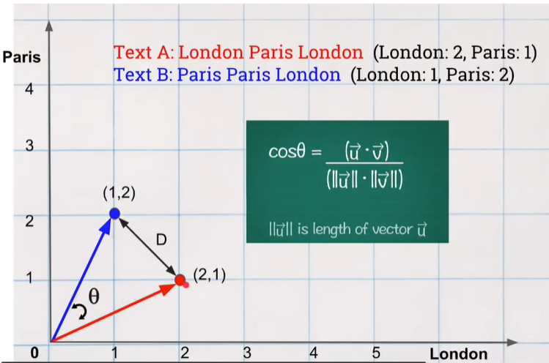
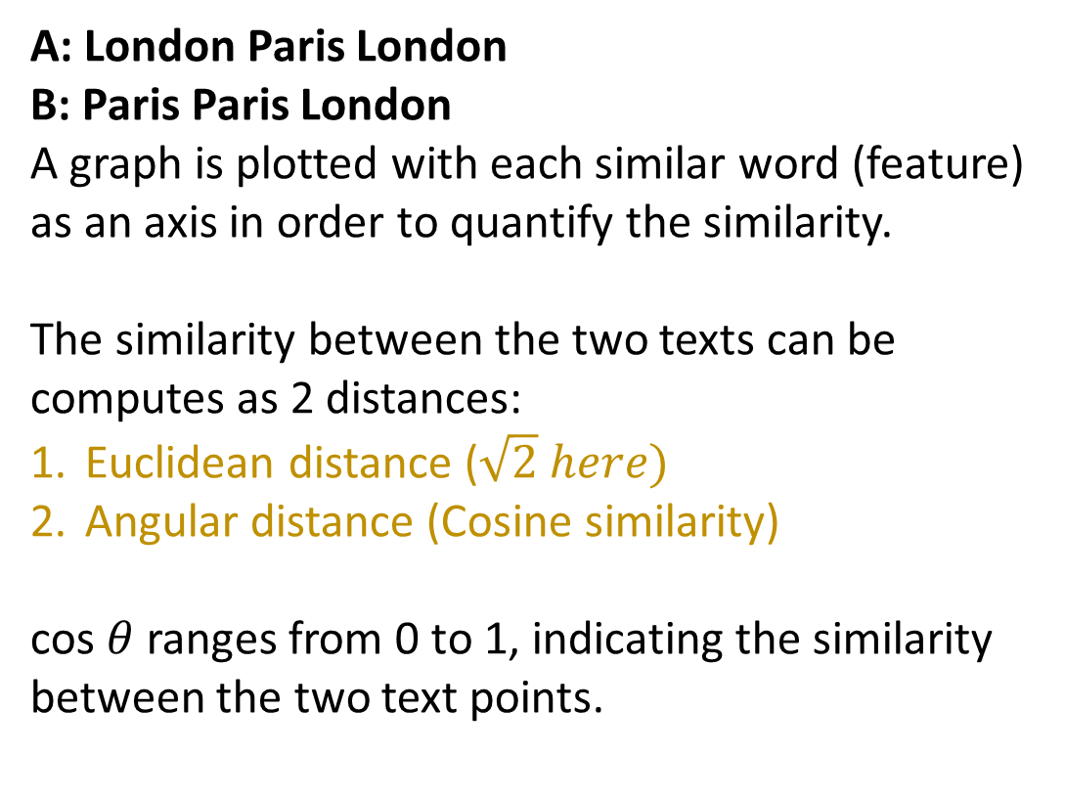
CONTENT-BASED RECOMMENDATION
A: London Paris London
B: Paris Paris London
A graph is plotted with each similar word (feature) as an axis in order to quantify the similarity.
The similarity between the two texts can be computes as 2 distances:
Euclidean distance ($\sqrt{2} here)$
Angular distance (Cosine similarity)
cos $θ$ranges from 0 to 1, indicating the similarity between the two text points.

Slide 6
STEPS TO BUILD A CONTENT-BASED RECOMMENDER SYSTEM
STEP 1: Read CSV file using panda library.
STEP 2: Select Features needed to find similarities from the columns in the data set.
STEP 3: Create a column in DF which combines all selected features.
Make a single column (a sentence for each row) from the selected columns.
STEP 4: Create count_matrix from this new combined column using CountVectorizer class in scikitlearn library.

Slide 7
STEPS TO BUILD A CONTENT-BASED RECOMMENDER SYSTEM
STEP 5: Compute cosine similarity based on count_matrix using cosine_similarity method in scikitlearn library.
STEP 6: Get index of a movie (input by user) from its title.
STEP 7: Get a list of similar movies in descending order of similarity score.
STEP 8: Print titles of first 10 movies.

Slide 8
COLLABORATIVE FILTERING
It relies on how other users responded to these same items. It doesn’t rely of features of the item, but the preferences from other users.
Similar users survey needs to be done.
We will focus on two main approaches; mainly
User-to-User CF (based on user preferences)
Item-to-item CF (based on rating given by users)\
Also collaborative filtering uses Angular distance (Cosine similarity) or Pearson’s
Coefficient of Correlation.

Slide 9
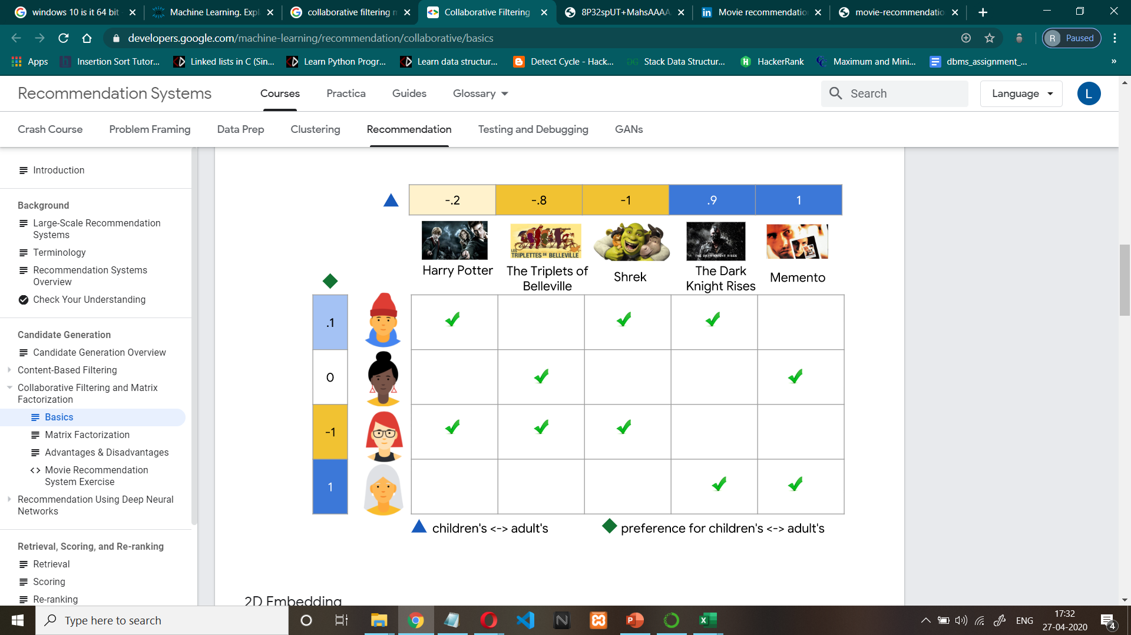

USER-TO-USER APPROACH
User 1 and user 2 has similar taste in movies

Slide 10
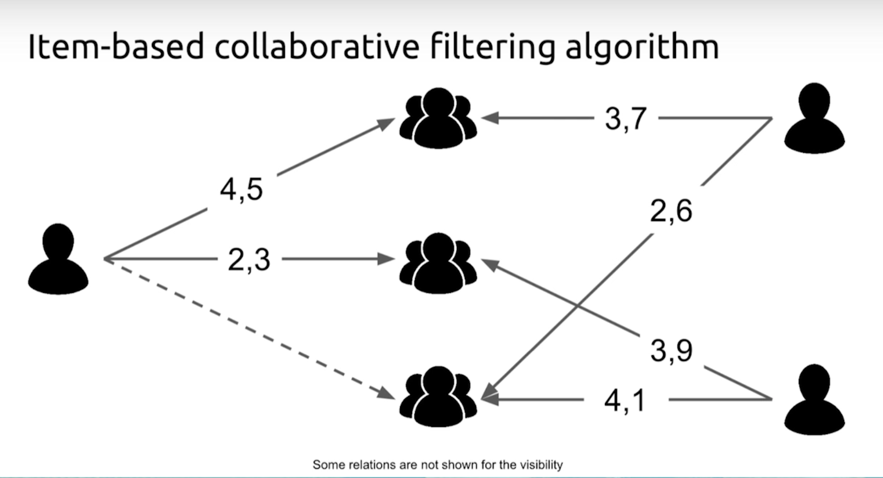
ITEM-TO-ITEM APPROACH (Ratings)
USER | BATMAN | INTER STELLAR | INCEPTION | ME BEFORE YOU
USER-1 | 5 | 4 | 4 | 3
USER-2 | - | 5 | 4 | 5
USER-3 | 4 | - | 4 | -
USER-4 | 3 | 4 | 5 | 3

Slide 11
STEPS TO BUILD A COLLOBORATIVE FILTRATION RECOMMENDER SYSTEM
STEP 1: Collect the data from the previously watched list (watchedlist.xls) of movies (stored
in an excel file).
STEP 2: Compare the data with the already pre-existing dataset (movies.csv). The pre-
existing data is the collection of movies along with the user ratings along with
other criteria.
STEP 3: Here we can obtain the movies watched by users with most similar rating patterns
using Pearson Coefficient of Correlation or Cosine Similarity method.

Slide 12
STEPS TO BUILD A COLLOBORATIVE FILTRARION RECOMMENDER SYSTEM
STEP 4: Sort the movies in descending order of the similarity score.
STEP 5: Print the top 10 similar movies.

Slide 13
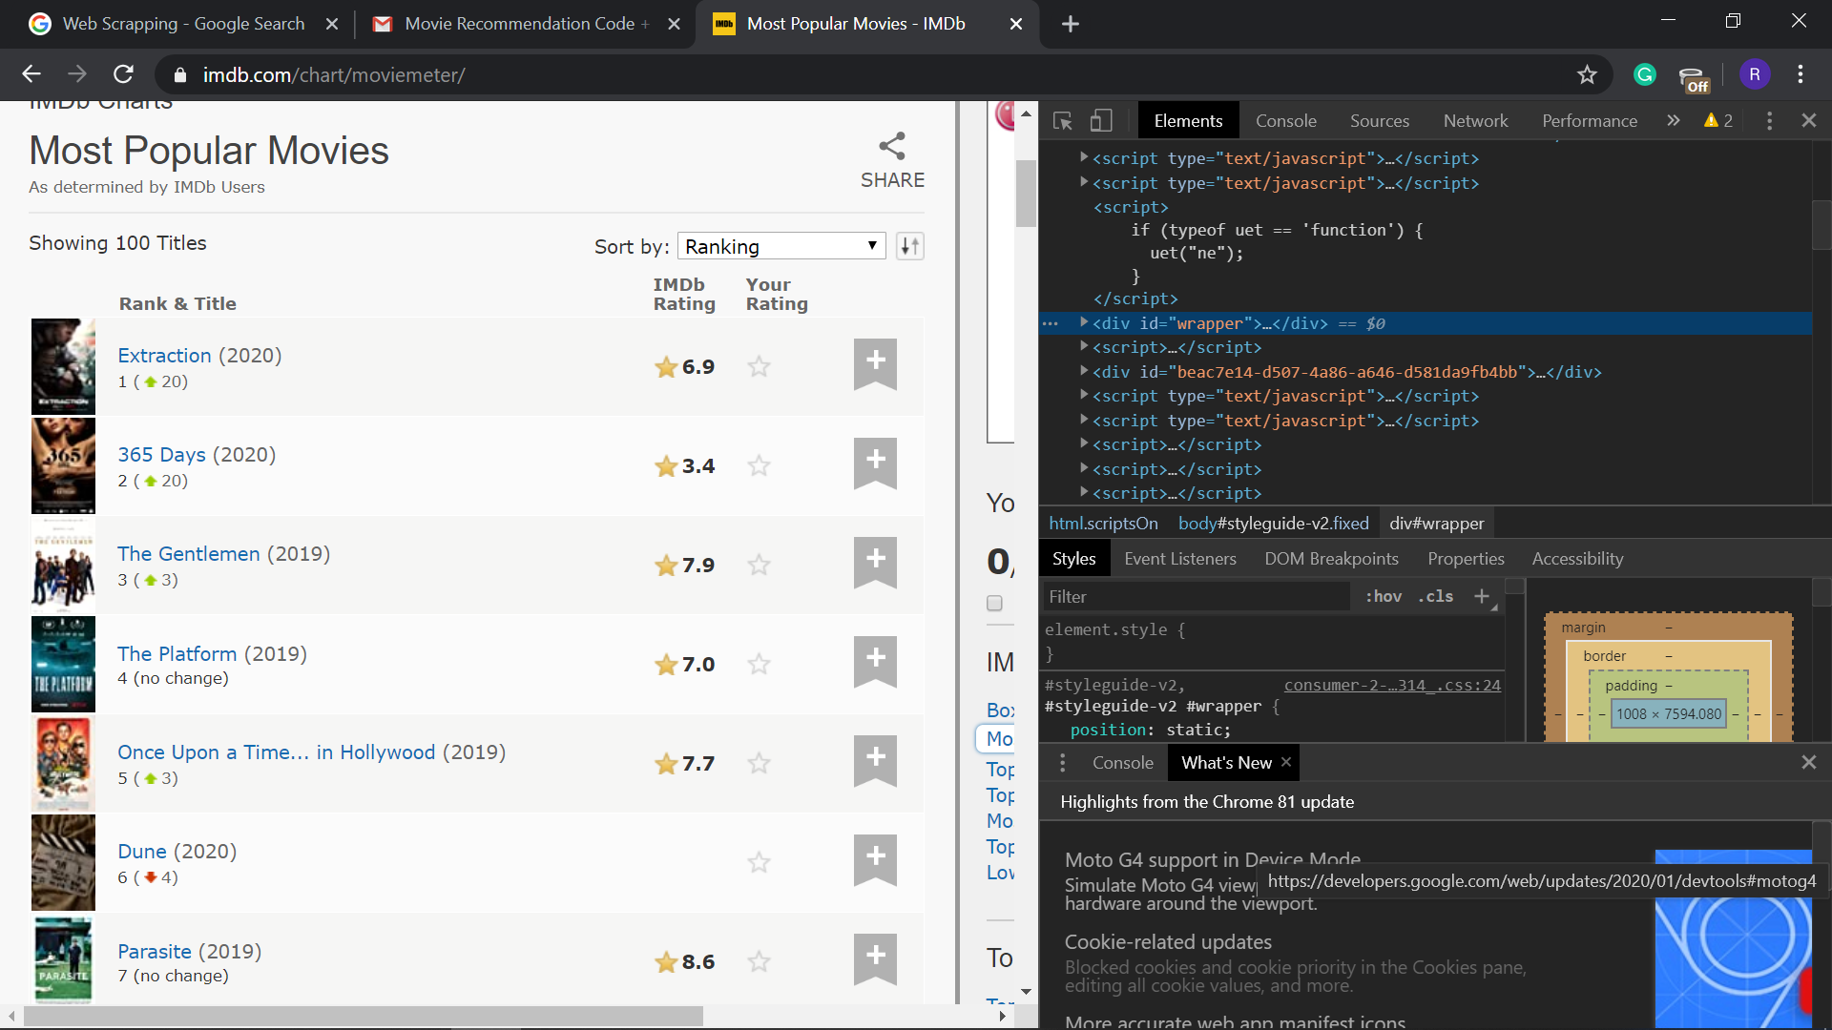
TRENDING MOVIE RECOMMENDATIONS
We use web scraping which is a technique used to extract data from webpages.
Python uses libraries such as requests, beautifulsoup to perform web scraping.
In our recommendation system, we scrape data from the IMDB website to recommend the trending/popular movies.

Slide 14
STEPS TO RECOMMEND POPULAR MOVIES BY WEB SCRAPING
STEP 1: Send a HTTP request to retrieve the data from specified IMDB website.
STEP 2: Extract the valuable part/payload of the data and convert it to a parse
tree from the extracted HTML document.
STEP 3: Find all the instances of the tag containing the movie names and store
them.
STEP 4: Convert all the collected data into text format and print the first 20
trending/popular movies.

Slide 15
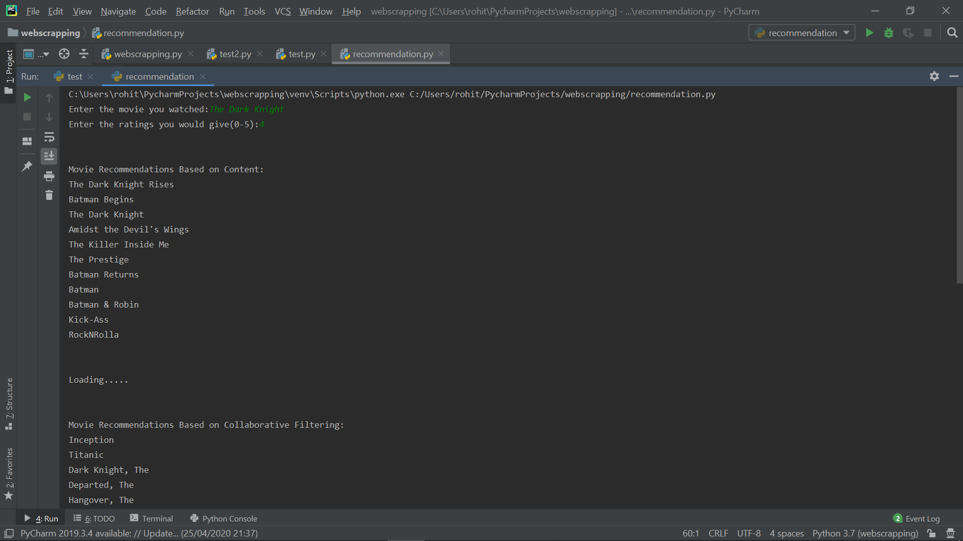
OUTPUT:

Slide 16
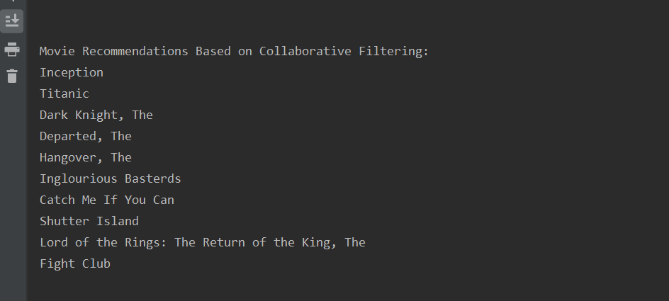
OUTPUT:

Slide 17
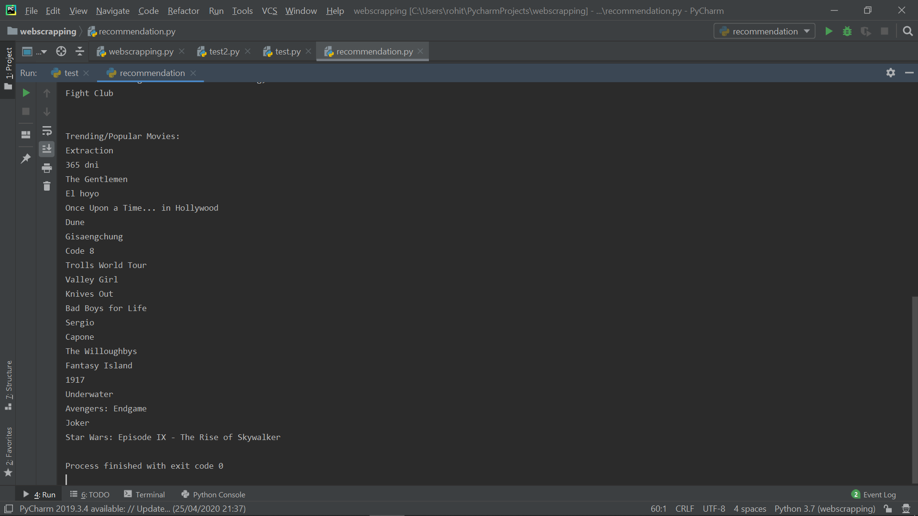
OUTPUT:

Slide 18
REFERENCES
GeeksforGeeks
YouTube
Stackoverflow
DigitalOcean
medium.com

